Slide 1
Review: Nonelementary Reaction Kinetics
Nonelementary reaction kinetics
  No direct correspondence between reaction order and stoichiometry
  Result of multiple elementary reaction steps and reactive intermediates (an intermediate so reactive it is consumed as fast as it is formed)
How do we determine the reaction mechanism?
Postulate a reaction mechanism that is a series of elementary reactions
Derive a rate equation for the postulated mechanism
Determine whether the rate eq for the postulated mechanism consistent with the experimental results. If it is, you’re done. If they are not consistent, go back to step 1.

Slide 2
Review: Postulating a Reaction Mechanism Based on an Experimentally Observed Rate Law
If C_{B} appears in the denominator of the experimentally observed rate law, then one elementary reaction step is probably:
where A* is a reactive intermediate
If the denominator contains a constant (by itself, not multiplied by a concentration), then one reaction step is probably:
If the numerator contains a species concentration, then one rxn step is probably:
Derive a rate equation for the postulated mechanism and check if it describes the experimentally observed rate equation
This will definitely be on quiz 3!

Slide 3
Review: Deriving a Rate Equation for a Postulated Mechanism
Write rate equation for postulated mechanism
2) For concentrations of reactive intermediates C_{I*} that appear in the rate equation –r_{A}
a) Write out the rate equation for reactive intermediates r_{I*}
b) Apply Pseudo-Steady State Hypothesis, which states that the net formation of reactive intermediates is zero (r_{I*}=0)
c) Solve for C_{I*} in terms of measurable species
d) Substitute the new expression for C_{I*} in terms of measurable species back into -r_{A}
3) Rearrange –r_{A} to check if it matches the experimentally observed rate equation

Slide 4
Review: Free Radical Polymerizations
M
M
M
monomer
M
M-M-M
polymer
M
M
n
1. Initiation:
Initiator (I) decomposes to 2 free radicals
Radical (1)
2. Propagation:
Chain elongation, new monomers add to chain
3. Chain transfer:
“Live” polymer chain transfers radical to monomer. Polymer chain is no longer reactive (dead). Can also transfer to solvent or other species
4a. Termination by addition:
4b. Termination by disproportionation:

Slide 5
Review: PSSH Applied to Thermal Cracking of Ethane
The thermal decomposition of ethane to ethylene, methane, butane and
hydrogen is believed to proceed in the following sequence:
Initiation:
Propagation:
Termination:
(a) Use the PSSH to derive a rate law for the rate of formation of ethylene
(b) Compare the PSSH solution in Part (a) to that obtained by solving the complete set
of ODE mole balance

Slide 6
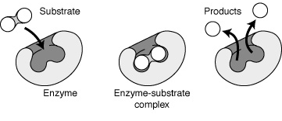
L10b: Bioreactors
Today’s goals:
  Predict rates of enzyme-catalyzed reactions
  Determine effect of chemical inhibitors on rxn rate
  Develop mathematical expression based on fundamental steps of rxn
  Apply model to cell growth
Enzymes: Protein catalyst that execute complex biochemical reactions- all synthetic and degradative reactions in living organisms!
Increases the rate of reaction without undergoing permanent chemical change – not used up (consumed) by the reaction
  Substrate: the reactant that the enzyme acts on

Slide 7
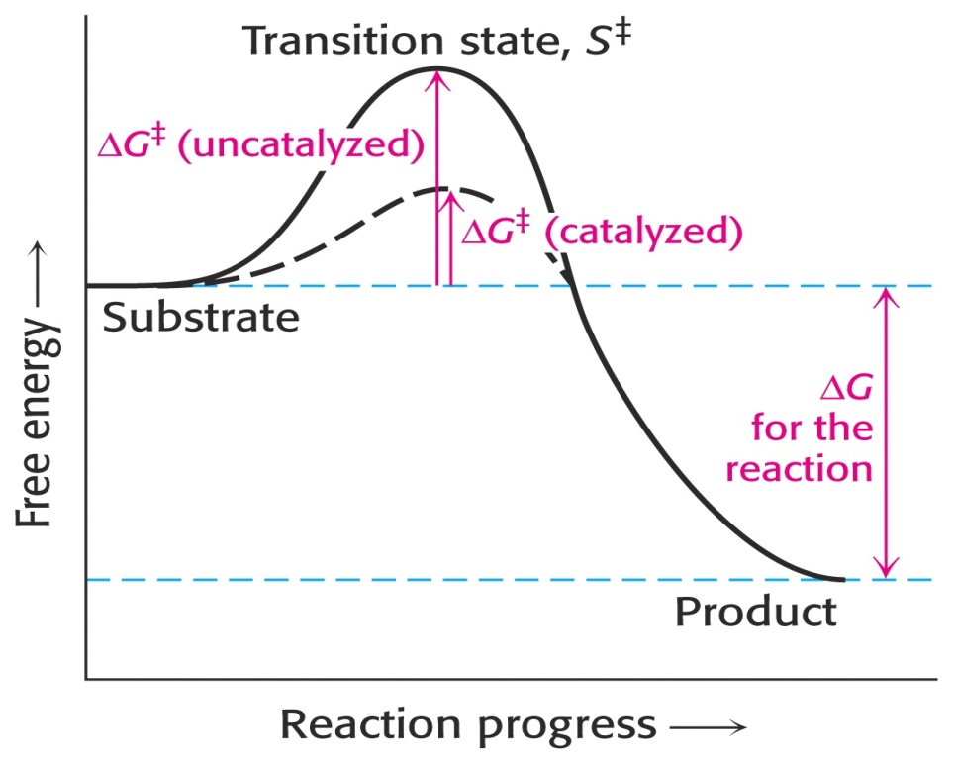
Enzymes Increase Reaction Rate
Effects the reaction rate (kinetics), NOT equilibrium (thermo)
Lower activation energy ΔG‡ increases reaction rate, reach equilibrium faster
ΔG is unchanged, so ratio of products to reactants at equilibrium is the same
Activation energy for uncatalyzed reaction
Activation energy for catalyzed rxn
k_{1,cat}>k_{1,uncat}
ΔG‡ determines rxn rate
ΔG‡ = -RT ln(k)
Enzymes change ΔG‡
Transition state, G‡
Thermodynamic:
Enzymes do NOT change ΔG
ΔG determines equilibrium
ΔG = -RT ln(K)
Enzymes do NOT change ΔG

Slide 8
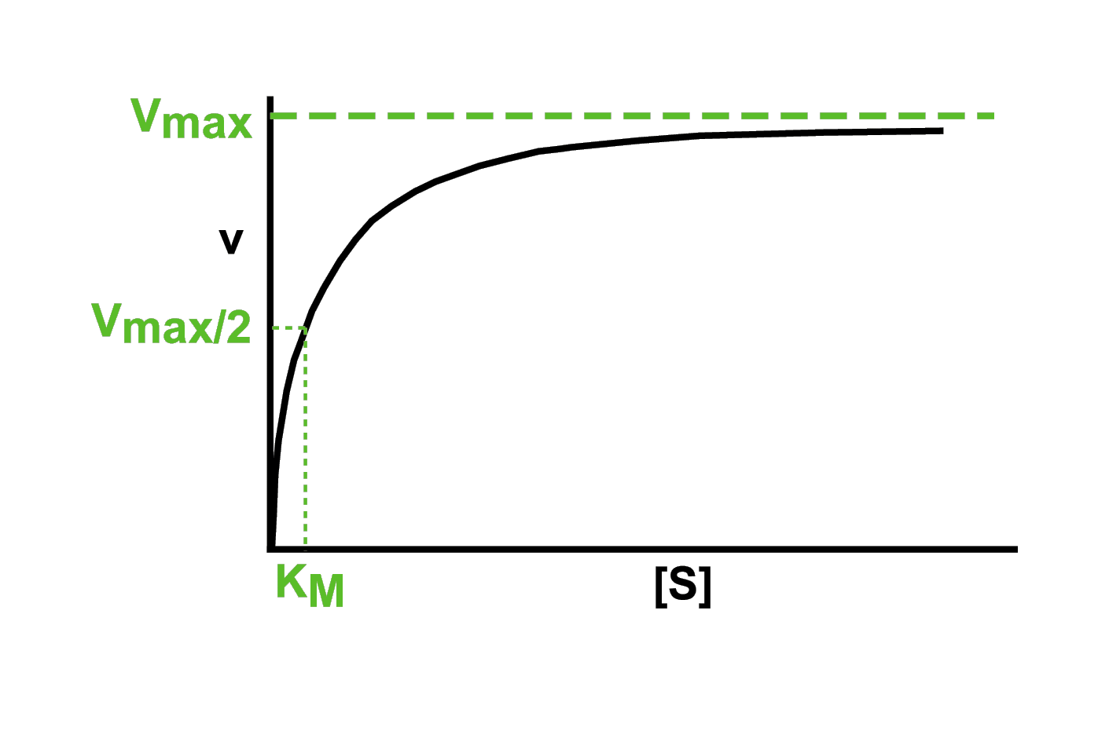
Michaelis-Menten (M-M) Equation
V_{max}: maximum reaction rate, further increases in substrate, S, no longer increase the reaction velocity, v
[r_{P}]
v = reaction velocity = r_{P} = -r_{S}
K_{m} = substrate concentration where reaction velocity v = V_{max}/2
[S] = substrate concentration [P]: product concentration
Empirically found the Michaelis-Menten equation:
Where V_{max} depends on the amount of enzyme

Slide 9
Rate Equation for Enzymatic Reaction
Goal: derive this experimentally determined reaction rate
E: enzyme S: substrate
ES: enzyme-substrate complex
We cannot measure C_{ES}, so we need to get C_{ES} in terms of species we can measure. Start by writing the rate equation for C_{ES} :
The free enzyme concentration C_{E} is also difficult to measure. Use the mass balance to get C_{E} in terms of C_{ES} and C_{E0}.
Substitute into rate eq for C_{E}:
Notes:
Participation question: connect inability to measure CES with reactive intermediate from the last lecture.

Slide 10
C_{ES} in Measurable Quantities
Pseudo-steady state assumption: ES is a reactive intermediate, so
Now solve for C_{ES}
Multiply out and rearrange
Bring C_{ES} to left side of equation
Factor out C_{ES}
Divide by quantity in bracket
Divide top & bottom by k₁
Plug this expression for C_{ES} into dC_{P}/dt

Slide 11
Derivation of the M-M Equation
E: enzyme S: substrate
ES: enzyme-substrate complex
Plug this expression for C_{ES} into dC_{P}/dt
Compare to experimentally observed rate eq:
When C_{S}>>K_{m}, then:
V_{max} occurs when enzyme is fully saturated with S (in ES form)
When C_{S}<<K_{m}, then:

Slide 12
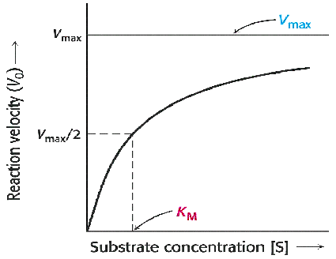
Complications with Measuring Rates with the M-M Equation
In practice, V_{max} can be difficult to estimate using the MM equation. Everyone reported different values of V_{max}.
Since a solution with infinite concentration of substrate is impossible to make, a different equation was needed.

Slide 13
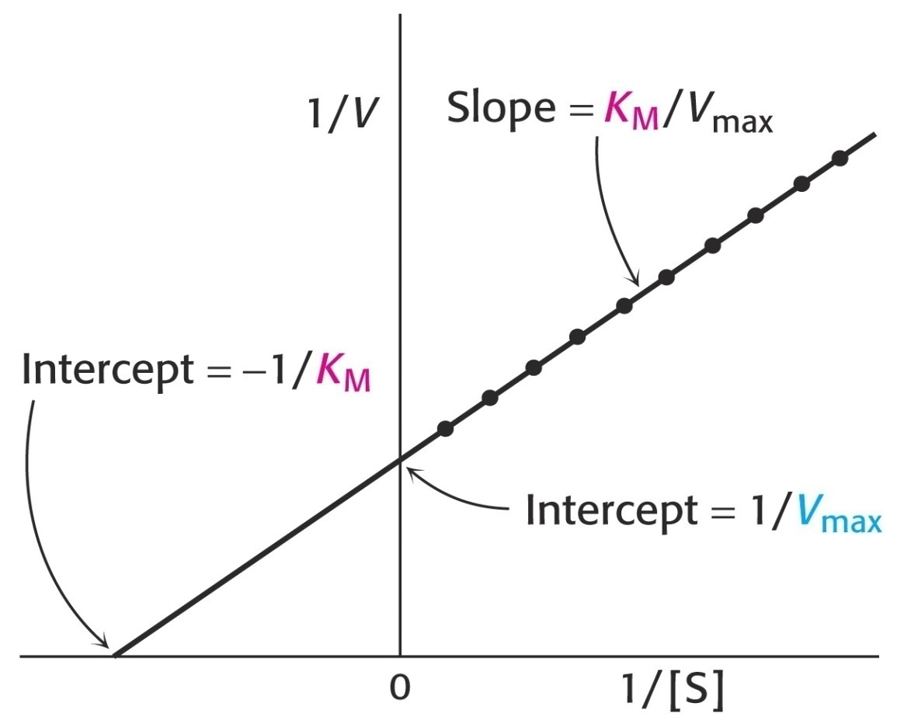
Lineweaver-Burk Equation
Lineweaver & Burk inverted the MM equation
By plotting 1/ v vs 1/C_{S},
a linear plot is obtained:
Slope = K_{m}/V_{max}
y-intercept = 1/V_{max}
x-intercept= -1/K_{m}

Slide 14
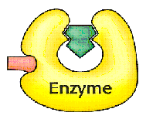
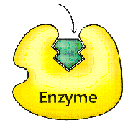
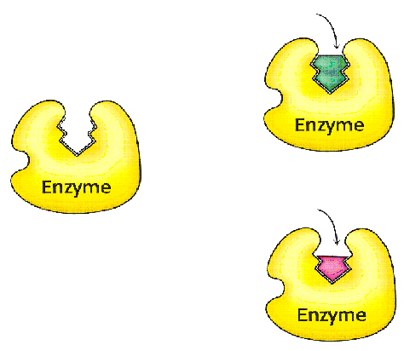
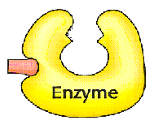
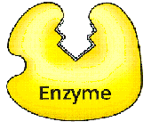
Types of Reversible Inhibition
Substrate
1. Competitive:
I is the inhibitor
Competitive
inhibitor
Binds to active site & blocks substrate binding
Reduces the C_{Enzyme} available for binding
Substrate
2. Noncompetitive
K’_{m}
K_{I}
K_{I}
Inhibitor binds to some other site
Does not affect substrate binding
K’_{m}

Slide 15
1. Competitive Inhibition
Competitive inhibition
No inhibition
Substrate and inhibitor
compete for same site
K_{m, app} >K_{m}
K_{m} observed w/ competitive inhibitor
V_{max, app} =V_{max}
Will reach V_{max} of uninhibited rxn at high C_{S}
Uninhibited reaction
Can be overcome by high substrate concentration
Slope = K_{m}/V_{max} y-int = 1/V_{max} x-int= -1/K_{m}

Slide 16
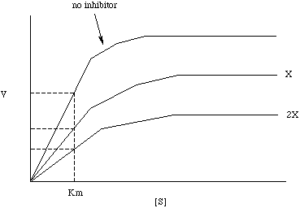
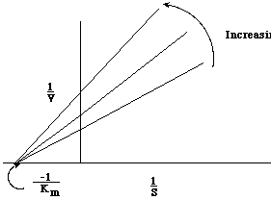
2. Noncompetitive Inhibition
Competitive inhibition
No inhibition
V_{max} observed w/ noncompetitive inhibitor
substrate and inhibitor bind different sites
Increasing
C_{I}
No I
V_{max}
V_{max,app}
r_{P}
C_{I}
V_{max,app}
higher C_{I}
K_{m}
C_{S}
V_{max, app} < V_{max}
K_{m, app} = K_{m}

Slide 17
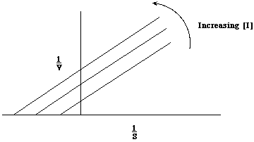
3. Uncompetitive Inhibition
E
S
I
substrate & inhibitor bind different sites but I only binds after S is bound
V_{max, app} < V_{max}
K_{m, app} <K_{m}
1/r_{p}
1/C_{S}
Notes:
For Lineweaver-Burk Plot, Both Km, apparent and Vm, apparent are smaller than Vmax and Km without inhibitor. Therefore both the y-intercept and x-intercept values change. However, the factor from the inhibitor cancels out, so the slope is Km/Vm.
E-H: the slope, Km, app, is decreasing as inhibitor increases and the y-intercept, Vmax, app, also decreases as the inhibitor increases.

Slide 18
Batch Bioreactor or Fermentor
C represents
cell mass
(biomass)
S₀
well stirred
reaction limited
C
S
C
S
S
C
S
S
S
C
C
S
Batch Reactor
In a reactor with substrate at concentration C_{S0} and C_{C} =0 add cells at concentration C_{C0} at t = 0 add no more S or cells after t = 0 monitor C_{S} and C_{C} with time
t=0 s
time

Slide 19
Kinetics of Microbial Growth (Batch or Semi-Batch)
Region 1: Lag phase
  microbes are adjusting to the new substrate
Region 2: Exponential growth phase
  microbes have acclimated to the conditions
Region 3:
Stationary phase
  limiting substrate or oxygen limits the growth rate
Region 4: Death phase
  substrate supply is exhausted
C_{C,max}
Log C_{C}
C_{C0}

Slide 20
Quantifying Growth Kinetics
Relationship of the specific growth rate to substrate concentration exhibits the form of saturation kinetics
Assume a single chemical species, S, is growth-rate limiting
Apply Michaelis-Menten kinetics to cellular system→ called the Monod equation
μ_{max} is the maximum specific growth rate when S>>K_{s}
C_{S} is the substrate concentration
C_{C} is the cell concentration
K_{s} is the saturation constant or half-velocity constant. Equals the rate-limiting substrate concentration, S, when the specific growth rate is ½ the maximum
Semi-empirical, experimental data fits to equation, assumes that a single enzymatic reaction, and therefore substrate conversion by that enzyme, limits the growth-rate

Slide 21
Monod Model (1942) – Nobel Prize
First-order kinetics:
Zero-order kinetics:

Slide 22
Mass Balance on Cell Growth with Products
Overall balance for cells growing on carbohydrate with products:
CH_{m}O_{n} + a O₂ + b NH₃ → c CH_{α}Ο_{β}N_{δ} + d CH_{x}O_{y}N_{z} + e H₂O + f CO₂
Carbohydrate
(can be any organic material)
Nitrogen source
Cell material
(biomass)
Product
Individual elemental balances:
Carbon: 1 = c + d + f
Hydrogen: m + 3b = cα + dx + 2e
Oxygen: n + 2a = cβ + dy + e + 2f
Nitrogen: b = cδ + dz

Slide 23
Yield Coefficients
Cell yield for substrate:
cell mass formed
substrate consumed
Cell yield for O₂:
cell mass formed
oxygen consumed
Product yield for substrate:
product mass formed
substrate consumed

